Slide 1
Virtual Body Control Module Using CANoe
R & D
Date: 30/05/2023

Slide 2
Index
Introduction
Canoe tool
Database Creation
Simulation setup
System variable
Panel Design
CAPL Scripting
Trace

Slide 3
Introduction
Introduction of Body Control Module (BCM)
In car for controlling front lights, rear lights and indicating fuel capacity, central lock, speed etc… are display on instrumental cluster.
Here in this we create that type of virtual display for front and rear lights and central lock.
For sending and receiving data frame different ECU (electronic control unit) are used.
Upon received frames how to react on that frame that we need to do in ECUs.

Slide 4
Introduction to CANoe
In CANoe we can create virtual platform so that from one ECU to another ECU we can transmit / Receive data frame.
To do virtual thing open CANoe and create file with CAN 500K baud 1ch.
Do the programming of ECU, so that on which data frame it need to react and which data frame it need to ignore.
CAN is message based protocol so, that message acceptance setting is present in the ECU As a programmer we have to do that message acceptance setting.
In panel design we can create such setup that some what we can see what happens in car with such programming.

Slide 5
Database Creation
To create database in CANoe
Tools -> CANdb++ Editor
Then how company/customer specify according to that identifier we need to create database in CANoe.
For that…
In CANdb++ Editor -> message and Right click
Doing that one window will be open

Slide 6
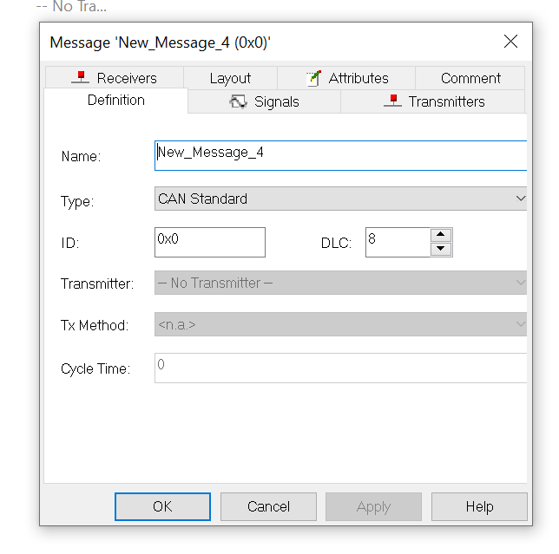
In that we need to provide name to that identifier and in ID we need to give identifier number for sending data frame with that identifier.
In comments for our understanding we can write for which operation we use that identifier.

Slide 7
Simulation Setup
In simulation setup we are taking ECU and connect those with the CAN bus.
For simulation setup
Simulation -> Simulation setup
To add ECU (nodes ) go to Network -> CAN network -> CAN -> Nodes -> right click -> insert network node
So, it will add one node in simulation setup
How many nodes we want that many we can add.

Slide 8
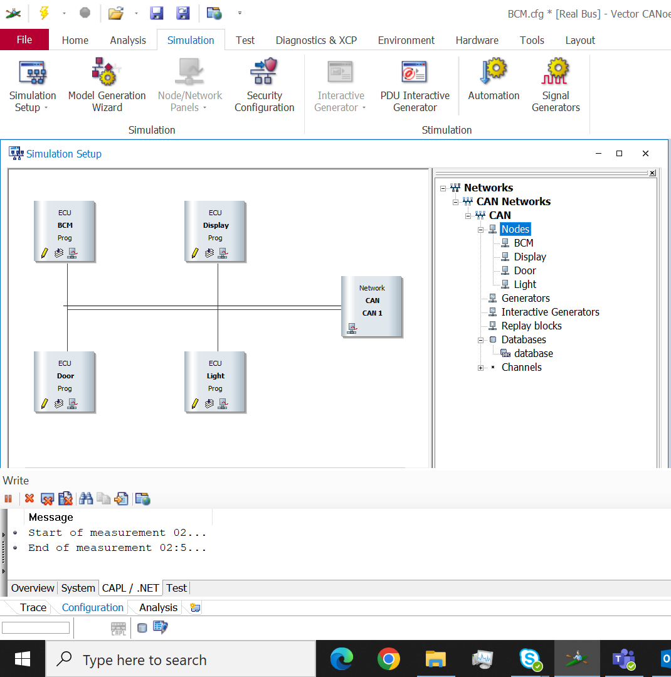
That simulation setup shows like this.

Slide 9
System Variable
System Variable are used to Attached with the devices which we are used in panel design
With that we can see the demo (animation) like what is happens
To create system variable
Environment -> System variables
Doing that one window will open and for creating system variable
Right click -> New
So that one another window will open, like shown below

Slide 10
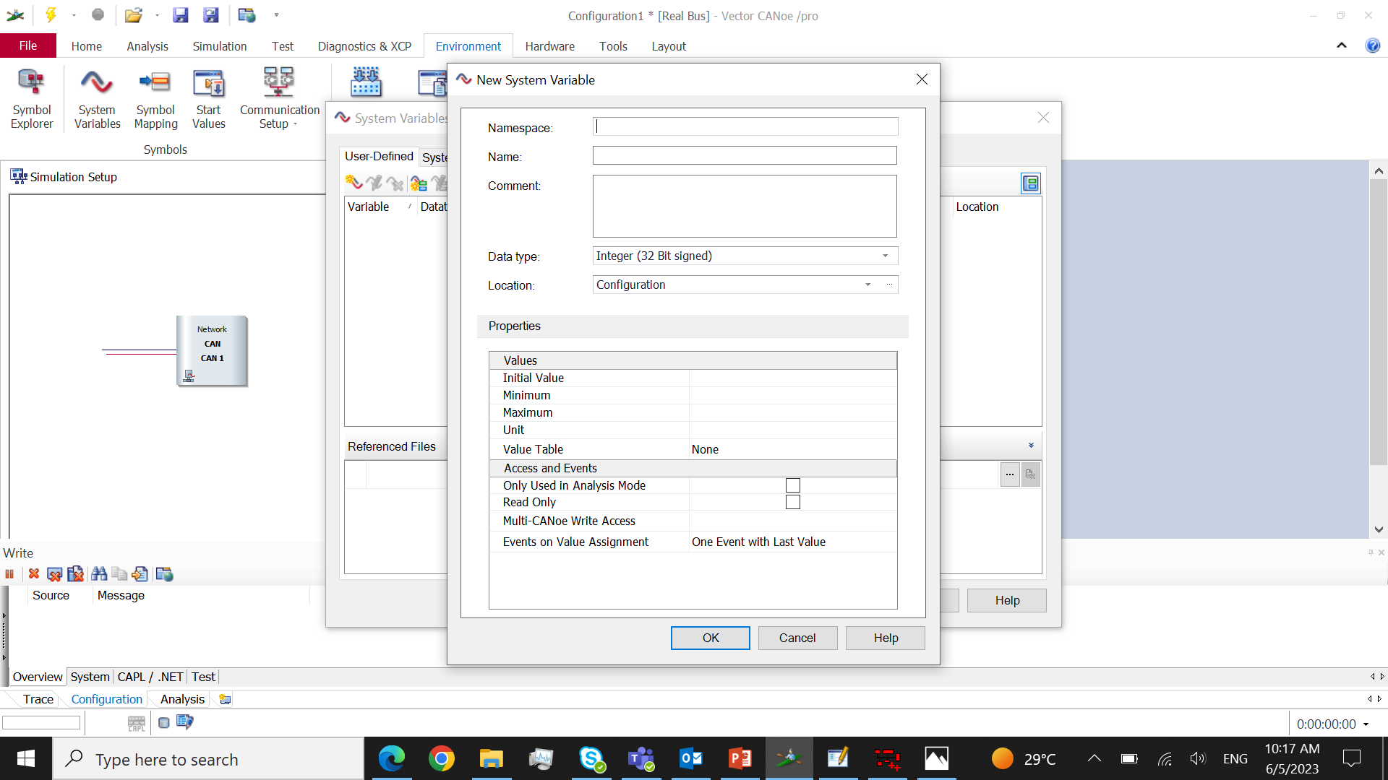
In that we have to provide namespace and name to the variable.
And also what type of variable that is, initial value for that variable, maximum to minimum value everything we can change.

Slide 11
Panel Design
Panel Design used to showing what actually happen as an animation using that we get to know that our product will work file or we need to do some change.
For designing the panel we have some tools.
With that tools we attach system variable which we create.
For creating Panel
Home -> Panel -> New Panel
So that one window will open in that window right side bottom two options are there toolbox and property.
Using toolbox we get tools and in property according to that tool we change shape, colour, etc…

Slide 12
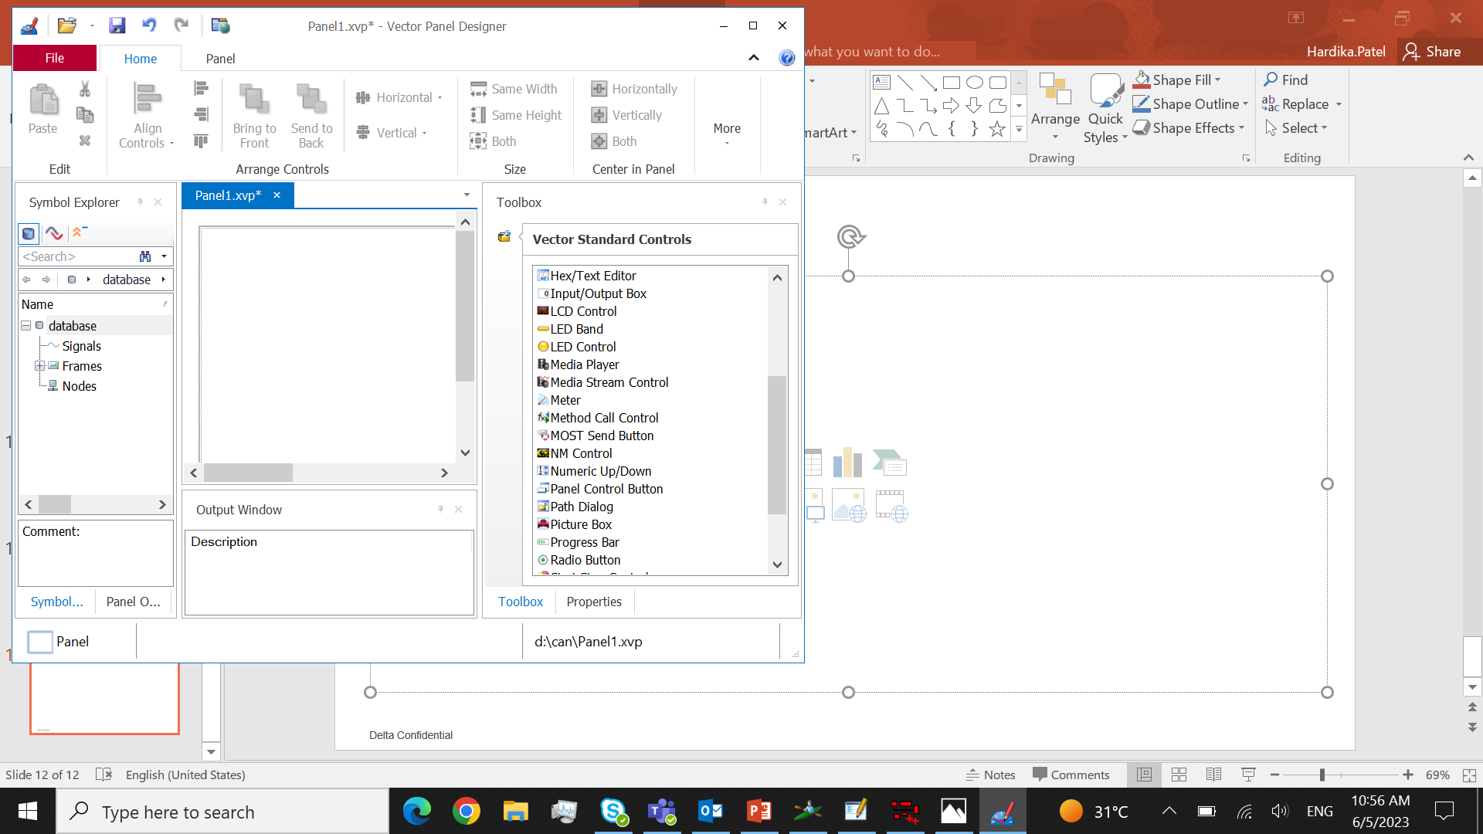
For take any tool drag and drop that tool.
And for attach the variable to that tool
Right click -> Attach variable
So one window will open, and in that window all the system variable we create that are shown.
So, select the system variable with which we want to connect tool and okay

Slide 13
CAPL Scripting
For CAPL scripting click on the pencil symbol of the respected ECU to do scripting/programming of that ECU.
When we click on pencil symbol one window will open that is CAPL browser.
In that CAPL browser we can write programming using some events, like on message, on key, on timer, set timer, on sysvar, etc…
In CAPL if we use any global variable then it will be declare in the variable block and if some header file we need to include then it will be declare in include block.

Slide 14
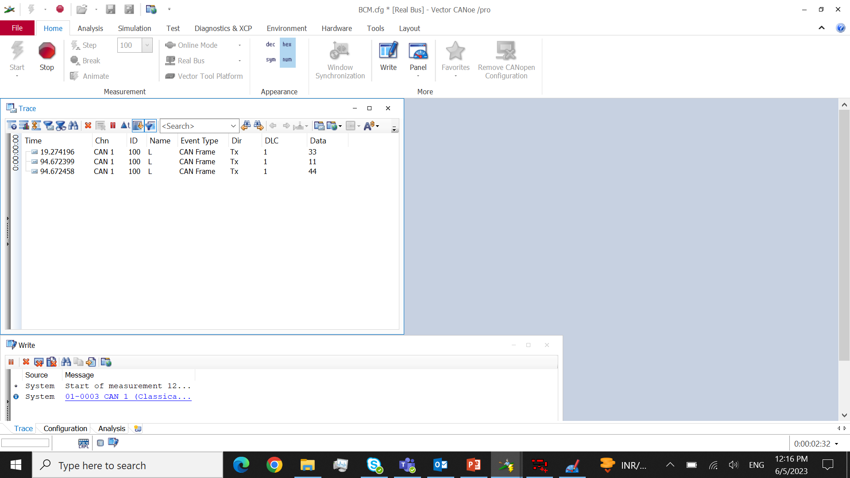
Trace
The trace window is used for knowing that which frame is transmit and receives.
And in that frame what data, which identifier, how many bytes that are seeing in that trace window.
To get trace window
Analysis -> Trace

Slide 15
Smarter. Greener. Together.
To learn more about Delta, please visit
www.deltaelectronicsindia.com

